Slide 1
United States Pollution Analysis
Katherine Layton, Richard Thomas, Jesse Eng, Charlie Smoot

Slide 2
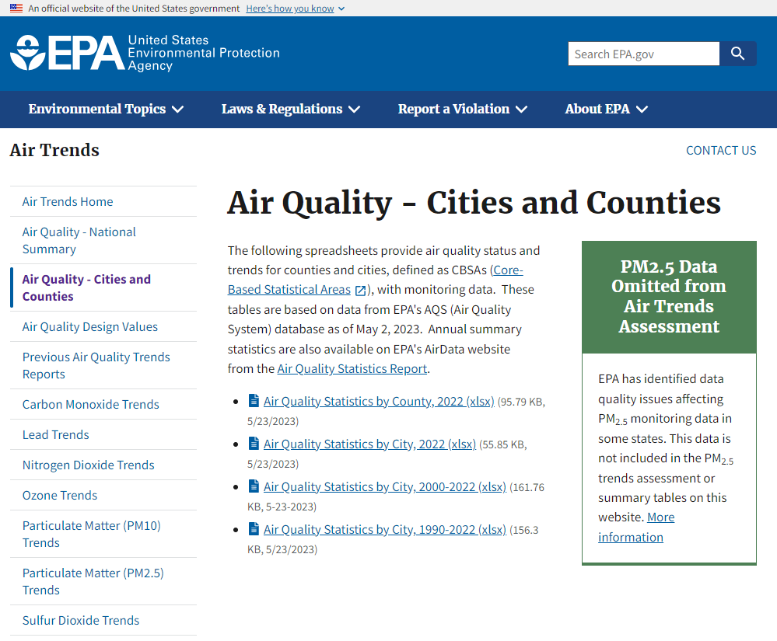
Data Source
For this project we utilized data.gov to find a data set that shows different pollution levels for various cities in the US from 2000-2022.
To map this data, we web scraped to collect latitude and longitude information for each city
https://dash.geocod.io/
Link to data: https://www.epa.gov/air-trends/air-quality-cities-and-counties

Slide 3
SQLite Database
This data was uploaded to a SQLite database so that we could query it with a python Flask API
CREATE TABLE IF NOT EXISTS public."HistoricalPollution" (
"Primary Key" integer NOT NULL,
"CBSA" integer,
"City" character varying(100) COLLATE pg_catalog."default",
"State" character varying(100) COLLATE pg_catalog."default",
"Pollutant" character varying(100) COLLATE pg_catalog."default",
"Trend Stat" character varying(100) COLLATE pg_catalog."default",
"Number of Sites" integer,
"1990" numeric, "1991" numeric, "1992" numeric, "1993" numeric, "1994" numeric, "1995" numeric,
"1996" numeric, "1997" numeric, "1998" numeric, "1999" numeric, "2000" numeric, "2001" numeric,
"2002" numeric, "2003" numeric, "2004" numeric, "2005" numeric, "2006" numeric, "2007" numeric,
"2008" numeric, "2009" numeric, "2010" numeric, "2011" numeric, "2012" numeric, "2013" numeric,
"2014" numeric, "2015" numeric, "2016" numeric, "2017" numeric, "2018" numeric, "2019" numeric,
"2020" numeric, "2021" numeric, "2022" numeric,
CONSTRAINT "HistoricalPollution_pkey" PRIMARY KEY ("Primary Key") );

Slide 4
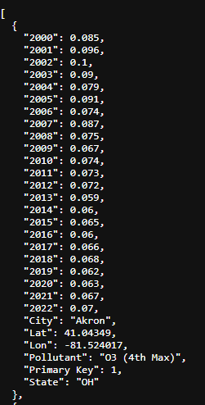


Python Flask API
A Flask API was setup that can serve the pollution data
This data was accessed via JavaScript using fetch('http://127.0.0.1:5000/api/v1.0/historical')

Slide 5
Live demo

Slide 6
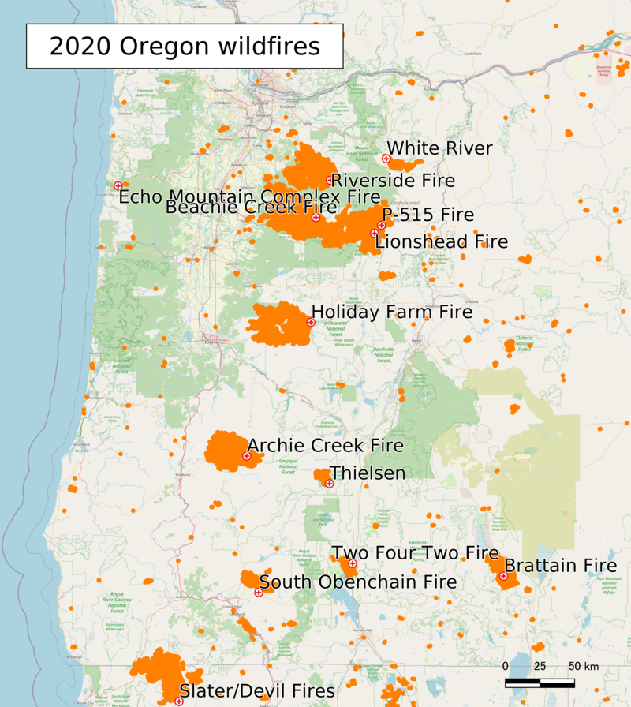
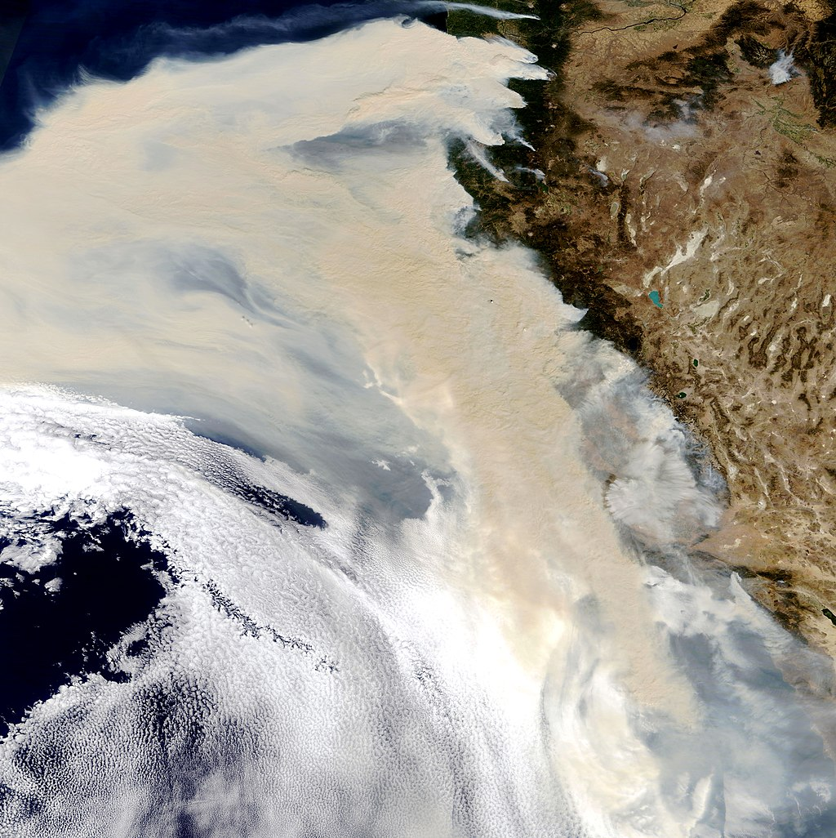
Eugene, Oregon Fires 2020

